Slide 1
Can machine learning models help us read CTG results?
Capstone Three presentation
By morgan Snellgrove

Slide 2
Did you know…
Every day, 800 women die from preventable causes related to pregnancy and childbirth around the world.
In 2021, 5 million deaths in children under the age of 5 was recorded, mostly from preventable and treatable causes.

Slide 3
United Nations World Health Goals
Reduce maternal mortality
Reduce newborn and under-5 mortality

Slide 4
Cardiotocography
Simple
Cost Effective
Improve Pregnancy Outcomes

Slide 5
Human Error in CTG Interpretation
Some measurements can’t be quickly calculated
High variability between interpretations
Inaccurate interpretations lead to negative outcomes.
Negative Outcomes
C-sections
Metabolic acidosis (build up of acid in the body)
Preterm delivery
Low birthweight
poor health metrics
A stay in NICU

Slide 6
Computerized Analysis of CTG Results
Can a computer accurately classify fetal health?
Studies show promising results!

Slide 7
2016 Study by Ignatov
Goal: Evaluate the effectiveness of Computerized CTG compared to conventional CTG
Sample size: N =720 women in active labor
360 women randomly assigned to computerized CTG, remaining giving conventional CTG
All newborns from both groups were assessed in the same way.

Slide 8
Their Conclusion:
The incidence of adverse perinatal outcomes was lower among women who were monitored by computerized CTG.

Slide 9
This ML project
Can we build a machine learning model to predict fetal health?
Our Data:
2126 examples of CTG readings.
Features extracted from CTG outputs and labeled by professionals
3 Categories:
Normal
Suspect
Pathological

Slide 10
Our Goals:
Greater than 80% accuracy
Class 3
recall greater than 90%
Identify most important features

Slide 11
Our Features
We have 22 columns
First 11 columns are measurements taken from the CTG
They deal with:
Baseline Rate
Variability
Accelerations
Decelerations

Slide 12
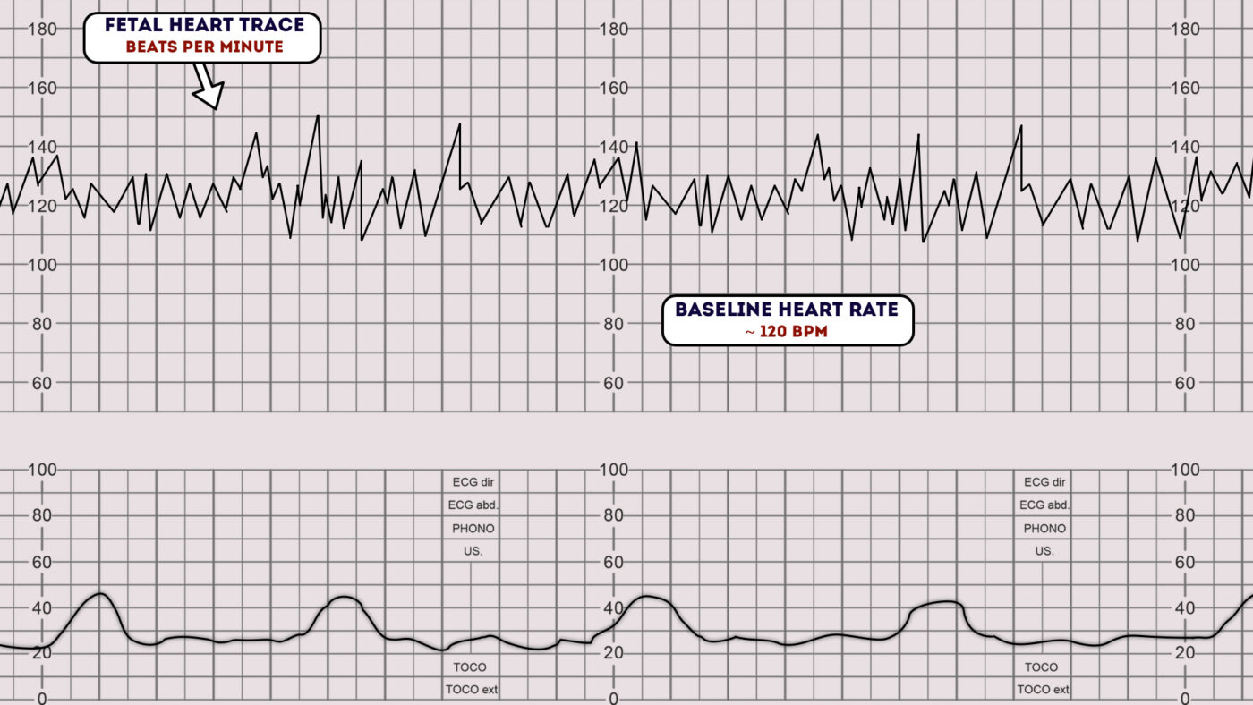
An example of a CTG printout

Slide 13

Baseline Rate
The average fetal heart rate
Normal is between 110 to 160 bmp

Slide 14
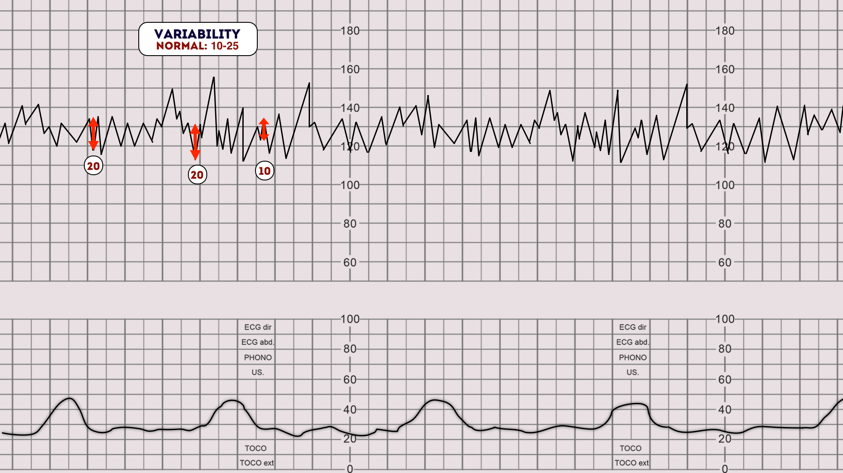
Variability
Fluctuations in fetal heart rate
Normal is between 5 to 25 bmp
Measured from peak to following trough

Slide 15
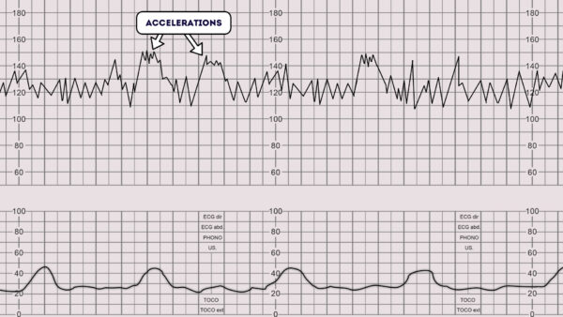
Accelerations
Short increases of FHR above the baseline
Above the baseline by >15 bpm for > 15 sec
A sign of good fetal health

Slide 16
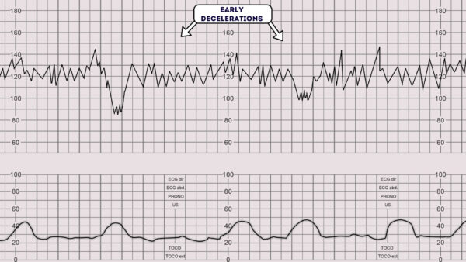
Decelerations
Short decreases of FHR below the baseline
Below the baseline by 15 bpm for 15 sec
Many different types

Slide 17
Histogram of Fetal Heart Rate
Remaining feature columns extracted from a histogram of FHR
Measures things like:
Mean
Median
Mode
Number of Peaks
Width
Max
Min

Slide 18
Positive Correlation with Target
Prolonged deceleration
Abnormal short-term variability
Percentage of time with abnormal long-term variability

Slide 19
Negative Correlation with Target
Accelerations
Uterine Contractions
Mean Value of Long-Term Variability

Slide 20
Early Models
Dummy Model for Baseline
First Real Models
Decision Trees
Accuracy: 89%
Class 3 Recall: 77%
Random Forest
Accuracy: 93%
Class 3 Recall: 89%
Just predict the most common class every time
Accuracy 78%
Class 3 Recall of 0

Slide 21
Best Multiclass Model
Gradient Boosting Classifier
Accuracy of 94%
Over 20% increase!
Class 3 Recall of 93%

Slide 22
Assessing the Models
All the models struggled the most with class 2 – Suspect.
Would combining Classes 2 and 3 into one category help?
New Categories:
1 = Suspect or Pathological
0 = Normal

Slide 23
Best Binary Model
Gradient Boosting Classifier
Accuracy of 96%
Class 1 Recall of 88%

Slide 24
Which is Better?
Suspect Category is hard to pick out
Worse Case: Pathological Classified as Normal
The Multiclass Model misclassified:
2 Pathological as Normal
19 Suspect as Normal
The Binary Model misclassified 14 cases as Normal
We don’t know if these were Suspect or Pathological
Keep all three classes

Slide 25

Conclusion
Machine Learning has a lot to offer in this area!
With the aid of computerized CTG we could:
Reduce the under-5 mortality rate
Improve decision making strategies for labor and delivery
Enable medical professionals to help more patients
Decrease the occurrences of negative outcomes for newborns

Slide 26
Questions and Continued Study
Since we are questioning the labels, it would be interesting to do a clustering analysis of the data without the labels.
It would be very helpful to have the negative outcomes for each birth.
How many of the Suspect cases were healthy babies?
How many of these healthy class 2’s did the model misclassify? In the end, who was right?
We need more studies with larger sample sizes.

